Slide 1
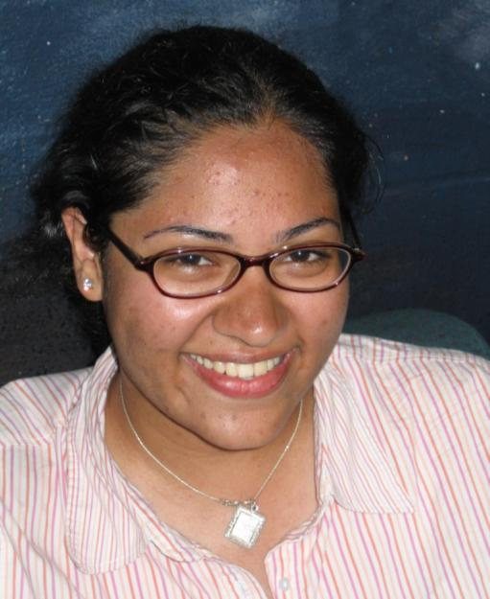
STUDENTS BECOME HISTORIANS WHEN THEY DO THE HISTORY FAIR
YOU ask a historical question that you want to answer.
YOU do research using books by historians and primary sources.
YOU analyze and come to your own conclusions and make your own argument supported by evidence.
YOU produce a project to present to the public.
HISTORY FAIR STUDENTS become…

Slide 2
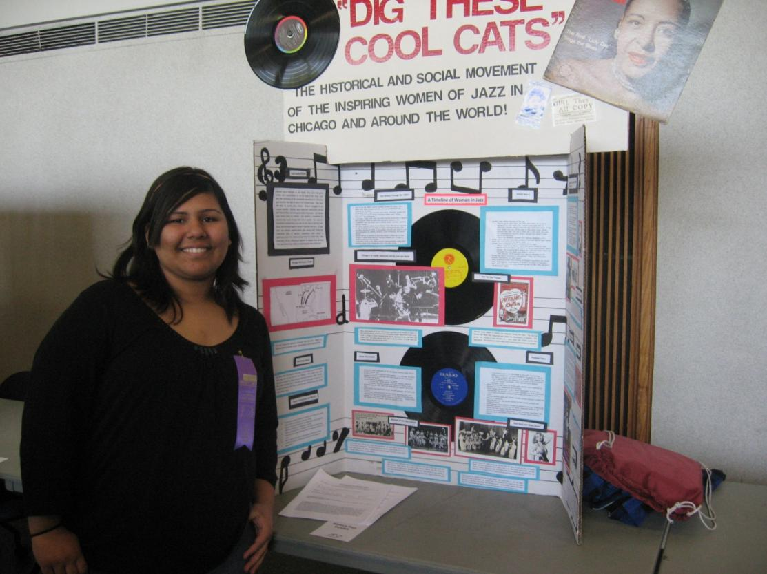
…museum curators and designers,

Slide 3
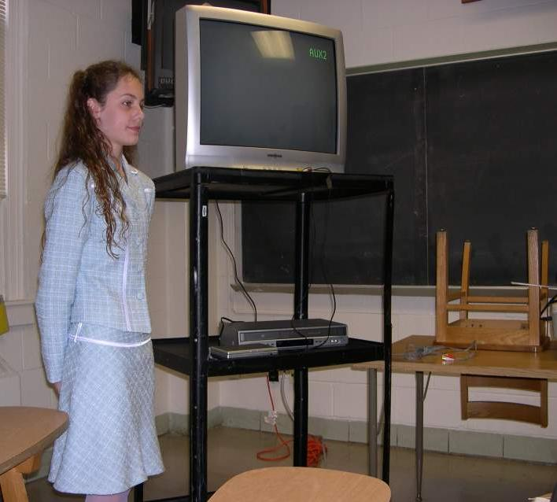
…documentary filmmakers,

Slide 4
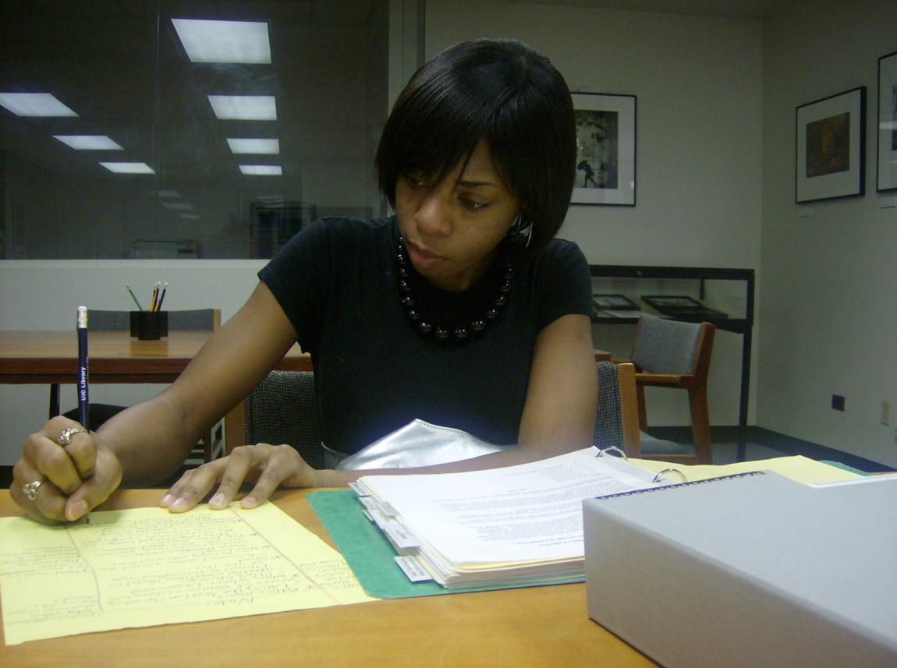
…scholars writing for a journal,

Slide 5
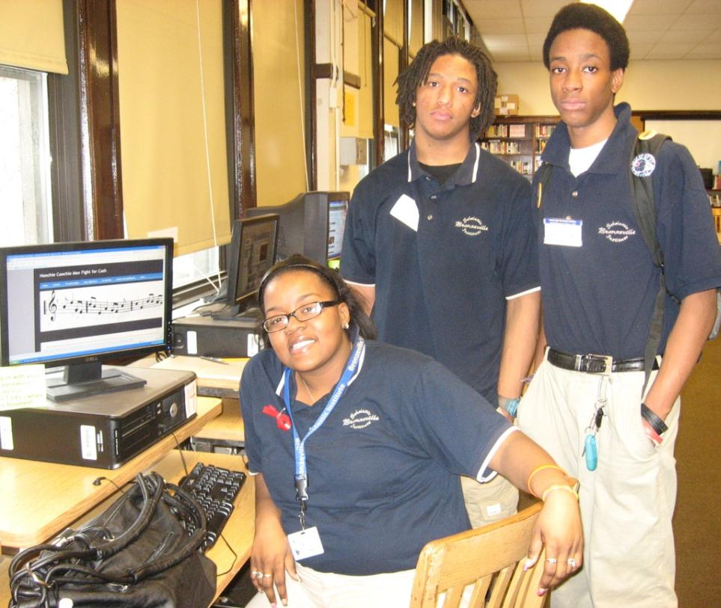
…website developers,

Slide 6
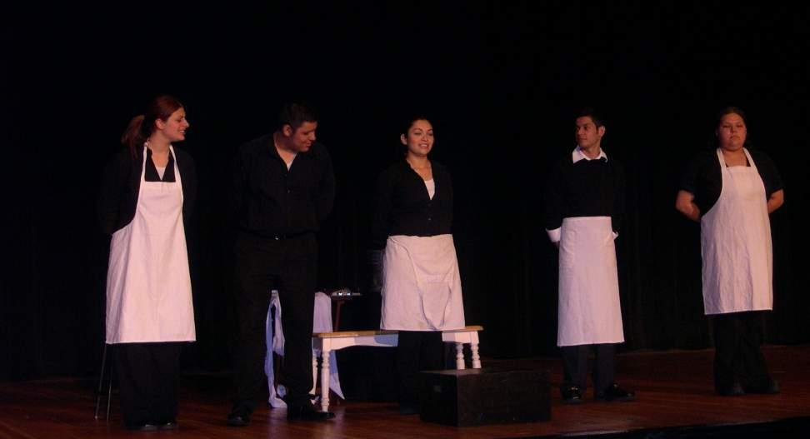
…and performers.

Slide 7
5 Steps for a Successful History Fair Project
5. Tell Us Your Story!
4. Develop an Argument
3. Analyze Your Sources
2. Take the Research Journey
1. Ask Questions and Find Your Topic

Slide 8
Step 1 I Wonder Why…
? ? ?
Ask Questions, Find a Topic

Slide 9
There are many ways to find topics…
What topics interest you?
Immigration, Ethnicity
Politics, Law
Labor, business
Technology, medicine
Arts, literature
Sports, Media
Civil and human rights
Women’s issues
Environment
— everything has a history!
What current events or issues concern you?
What career do you want to have as an adult?
What period of history is most intriguing for you?
Notes:
It is essential to have students a lot of brainstorming before latching on to a couple ideas to pursue. Have them make a list of 50 to 100 answers.

Slide 10
…or consider the big questions that you especially care about:
How do the arts change society?
How do people gain rights and share power?
What happens to people, communities, nations in times of war?
How do music, sports, dance, or writing impact history?
How did my community get this way?
What do people do when the economy changes?
Notes:
It is essential to have students a lot of brainstorming before latching on to a couple ideas to pursue. Have them make a list of 50 to 100 answers.

Slide 11
Where you can look for ideas…
Encyclopedia of Chicago, Chicago History, other Chicago-based publications
Newspapers and magazines
Museums and cultural organizations
Your history book
Archives’ and special collections’ finding aids
Talk to people!

Slide 12
It’s historically significant.
It can be argued -- interpreted.
It’s history – happened in the past, and shows change over time.
It’s connected to Chicago.
Your History Fair Topic Question
It’s got soul! YOU CARE ABOUT IT!
It’s got sources.
It uses the NHD theme for analysis.
Notes:
Developing your question– we leave a copy of the “radiant sun” (2/s version) for teachers to make and distribute. Criteria (“radiant sun”Local—connected to chicago
Historical—in the past, change over time
Researchable (has sources)
Can make your own interpretation—take a stand (thesis)
Historically significant—made an impact, lessons for today, influence people, ideas,events
Analyzes with/relates to theme
Have students produce a one page essay or “topic proposal” where they defend their idea for their History Fair project.

Slide 13
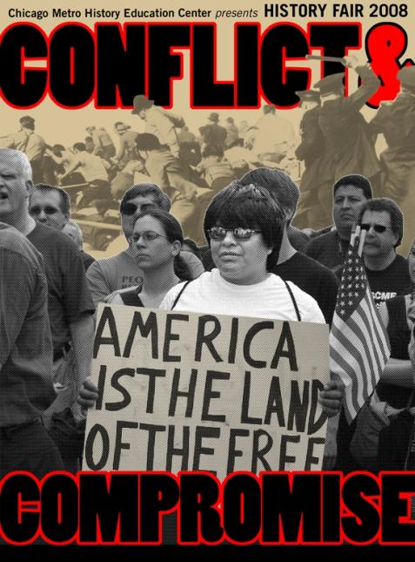
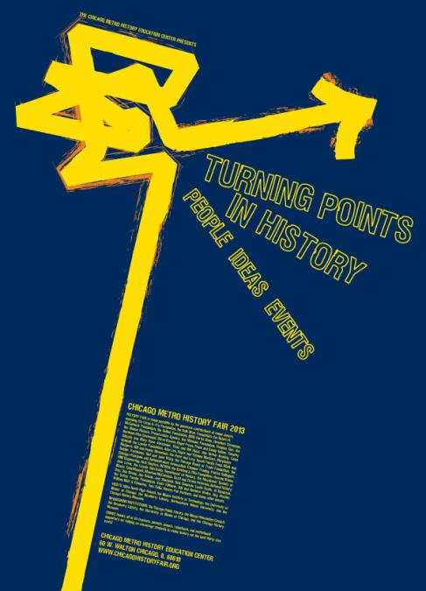
Each year, History Fair offers a theme to use with your topic
WHAT IS THIS YEAR’S NATIONAL HISTORY DAY THEME?
Notes:
The following exhibits show the use of the themes from 3 different years. It also gives an opportunity to talk about exhibit design – clear and creative, organized-especially with subtitles, lots of visual evidence various degrees….

Slide 14
The following exhibits from previous years show how your interests and topic ideas usually can connect to the current theme….

Slide 15
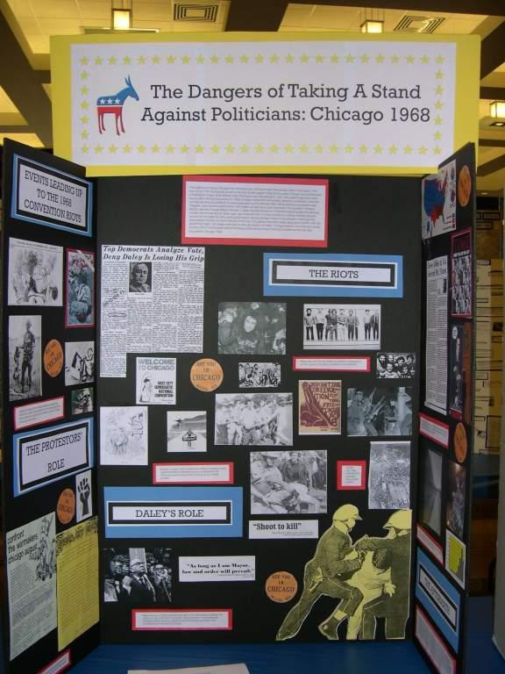
“Taking a Stand”
Notes:
Here’s an example of a project when the theme was “Taking a Stand”

Slide 16
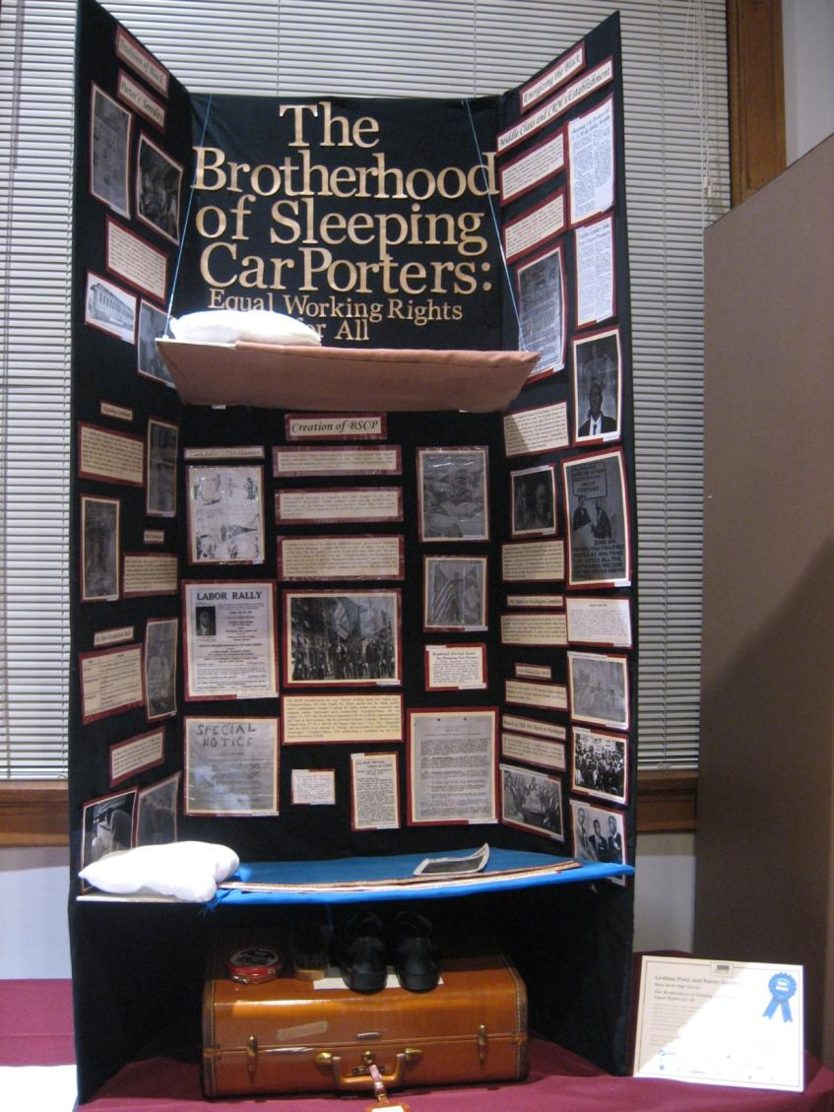
“Revolution, Reaction, and Reform”
Notes:
2012 theme boards that can be argued to contain a Turning Points perspective.

Slide 17
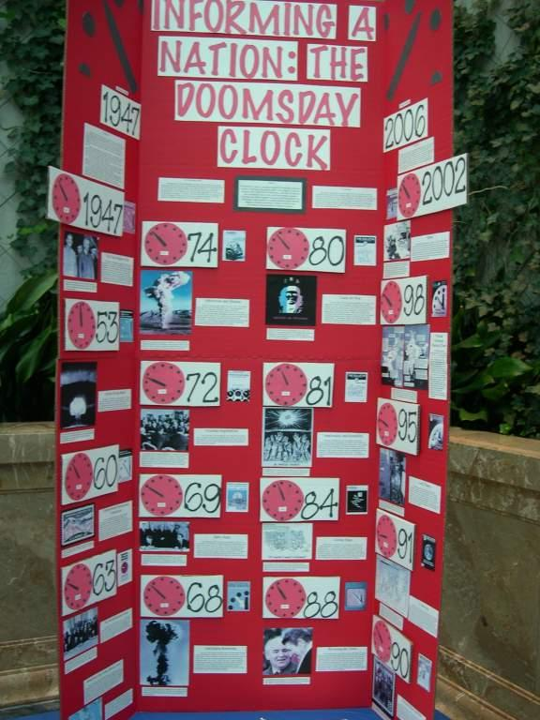
“Communication in History”
Notes:
“Communication: A Key to Understanding” was the theme

Slide 18
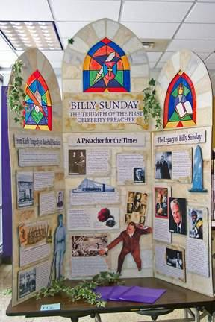
“Triumph & Tragedy in History”
Notes:
The project look at Billy Sunday through the Tragedy and Triumph theme

Slide 19
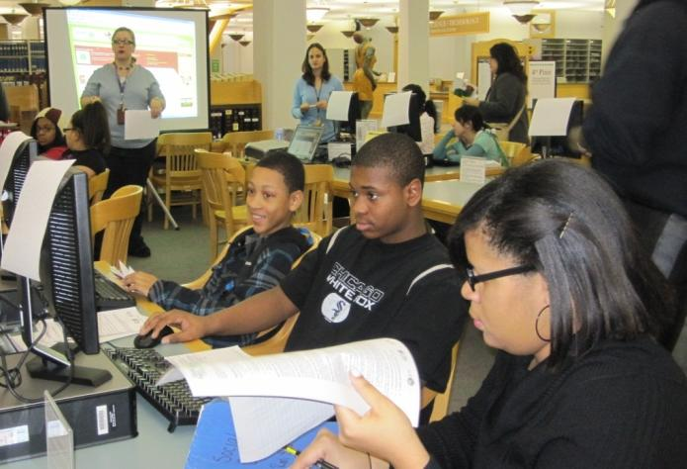
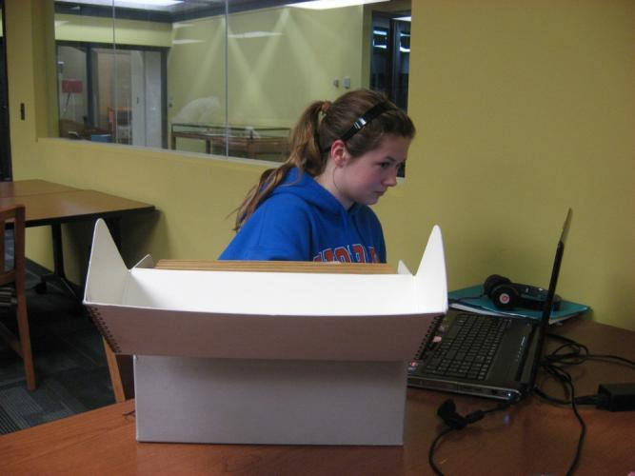
Step 2 What does History Fair research look like?
The Research Journey
Notes:
Research is the key that will help you develop your own voice and the ability to tell a compelling and convincing story of the past. Also, tell folks what you are doing—they make actually have a story or contact or source for you. See the Research Journey powerpoint under our “Making History” tab

Slide 20
Research is a journey. You start it when you seek a topic and question and then go farther to develop your thesis and argument.

Slide 21
What changed? How and why? What was the impact? What was its significance?
Always the “big questions” of history.
A specific aspect of history to analyze.
NHD THEME
Research!!
INVEST TIME IN FINDING THE TOPIC
Notes:
Integrated into the theme—not pasted on! Followed by the topic (sports, transportation, women’s rights, civil rights, wars, immigration… Could show discuss how topic of immigration could lead in many directions—and this is where finding a story or relating to the Then the theme comes in. The next slides show each phase, but the final one has everything if you only want to use one. This is a time to talk about looking at special collections, talking with family, other teachers, community people to FIND a good source related to your broad topic and have the sources guide you.

Slide 22
What changed? How and why? What was the impact? What was its significance?
Always the “big questions” of history.
A specific aspect of history to analyze.
I love TV!
NHD THEME
BROAD TOPIC
Research!!
INVEST TIME IN FINDING THE TOPIC

Slide 23
What changed? How and why? What was the impact? What was its significance?
Always the “big questions” of history.
A specific aspect of history to analyze.
I love TV.
Hey, I didn’t know that Chicago was once famous for its television programs. Wow!
2013 Theme is “Turning Points in History: People, Ideas, Events”
BROAD TOPIC
Research!!
Narrowed Topic
INVEST TIME IN FINDING THE TOPIC
Notes:
Personal connections and “I Wonder” questions can help a student narrow the topic and find a historical question. This exploration is a VITAL part of developing a historical question, and then after a more research, a working thesis.

Slide 24
What changed? How and why? What was the impact? What was its significance?
Always the “big questions” of history.
A specific aspect of history to analyze.
I love TV.
Hey, I didn’t know that Chicago was once famous for its television programs. Wow!
Did Chicago TV produce any turning points in history?
NHD THEME
BROAD TOPIC
Research!!
Narrowed Topic
Historical Question
INVEST TIME IN FINDING THE TOPIC
Notes:
Essential questions of history--- followed by the theme (power)…. Followed by the topic (sports, transportation, women’s rights, civil rights, wars, immigration…

Slide 25
INVEST RESEARCH TIME IN FINDING THE TOPIC
What changed? How and why? What was the impact? What was its significance?
Always the “big questions” of history.
A specific aspect of history to analyze.
I love TV!
I didn’t know that Chicago was once famous for its television programs. Wow!
Did Chicago TV produce any turning points in history?
Chicago School of Television’s pioneering informal style broke down barriers between the audience and performers which represented a turning point that changed Americans’ relationship to television.
NHD THEME
BROAD TOPIC
Research!!
Narrowed Topic
Historical Question
Historical Question
Working Thesis
MAIN RESEARCH!
Notes:
Essential questions of history--- followed by the theme (power)…. Followed by the topic (sports, transportation, women’s rights, civil rights, wars, immigration… the same essential applies even if NO doing the theme. Do some samples (have planned out in advance…)

Slide 26
Doing History Fair research means you will:
Notes:
What are you looking for?? Background, facts, different perspectives (as well as different theses…)

Slide 27
What are secondary sources? Materials that give information, make an argument or offer interpretation based on primary sources. Use secondary sources first to gather basic information on your topic - including the background and context.
Notes:
THIS IS VERY VERY IMPORTANT!!! What can you get from secondary sources? Why do you need them? Trick about following the footnotes/citations in books and magazines for primary and secondary sources.

Slide 28
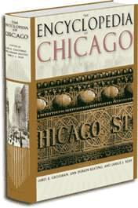
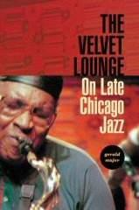
BOOKS or ARTICLES
by historians on a narrow subject
by historians that summarize or synthesize others’ works
by writers summarizing historians
Encyclopedia & general reference books
Interviews with scholars, experts, museum docents, or others with second-hand knowledge
ALWAYS START
Notes:
THIS IS VERY VERY IMPORTANT!!! What can you get from secondary sources? Why do you need them? Trick about following the footnotes/citations in books and magazines for primary and secondary sources.

Slide 29
What are Primary Sources?
Material made at the time - for the time, or persons who were witnesses or participants.
Primary sources are the “voices into the past” that make history come alive. They are also the historian’s EVIDENCE.
Notes:
What are primary sources??? Original manuscripts, records, or documents created at the time an event occurred. People who are participants or witnesses are primary sources too.

Slide 30
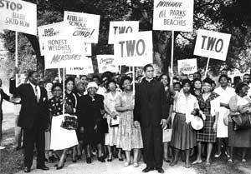
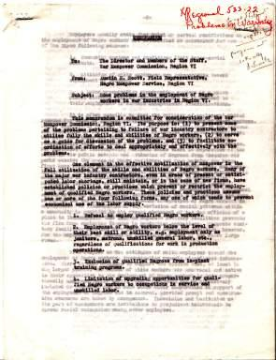
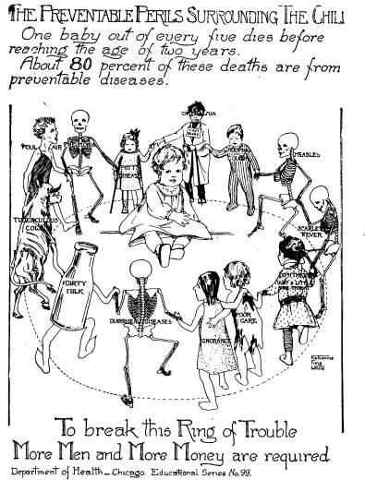
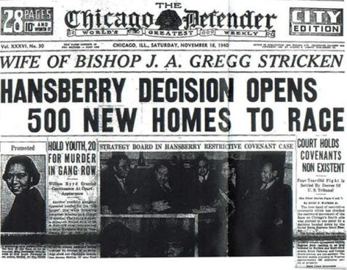
Speeches
Letters
Photographs
Interviews
Diaries
Posters, flyers
Newspapers, serials
Minutes or reports, government documents
Notes:
When asked, everybody hold up a sign and then draw it out. It could be “name a type of primary source” OR it could be—one image and students say (or hold signs that indicate primary or secondary….) offer both versions… OR do a mix-up for final one and kids have to say “primary” or secondary”. ALSO, ON ANY THE SLIDES, IT IS A GOOD TIME FOR A LITTLE SOURCE ANALYSIS…. WHAT DO YOU LEARN FROM THIS DOCUMENT? WHAT IT IT HELPING TO EXPLAIN ABOUT THE TIME, CONTEXT, AUDIENCE, PURPOSE, ISSUES, IMPACT, SIGNIFICANCE

Slide 31
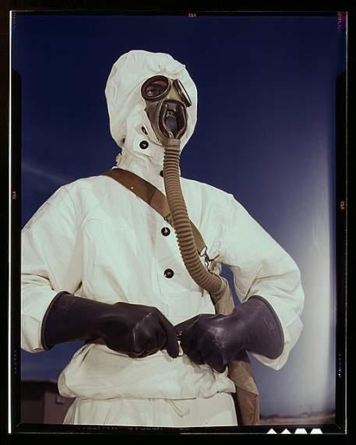
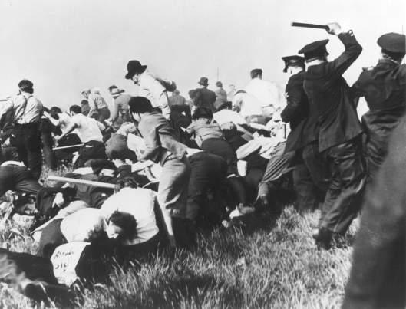
Photographs
Notes:
When asked, everybody hold up a sign and then draw it out. It could be “name a type of primary source” OR it could be—one image and students say (or hold signs that indicate primary or secondary….) offer both versions…

Slide 32
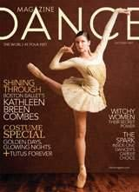
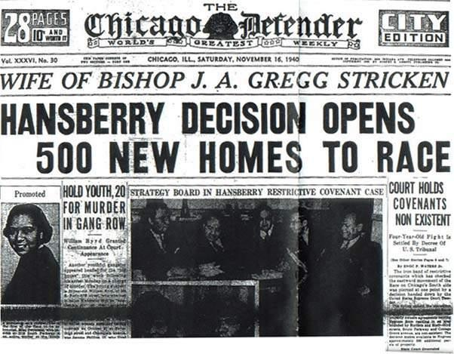
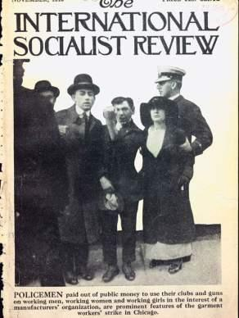
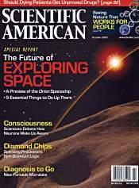
Newspapers, periodicals and serials (magazines)
Notes:
When asked, everybody hold up a sign and then draw it out. It could be “name a type of primary source” OR it could be—one image and students say (or hold signs that indicate primary or secondary….) offer both versions…

Slide 33
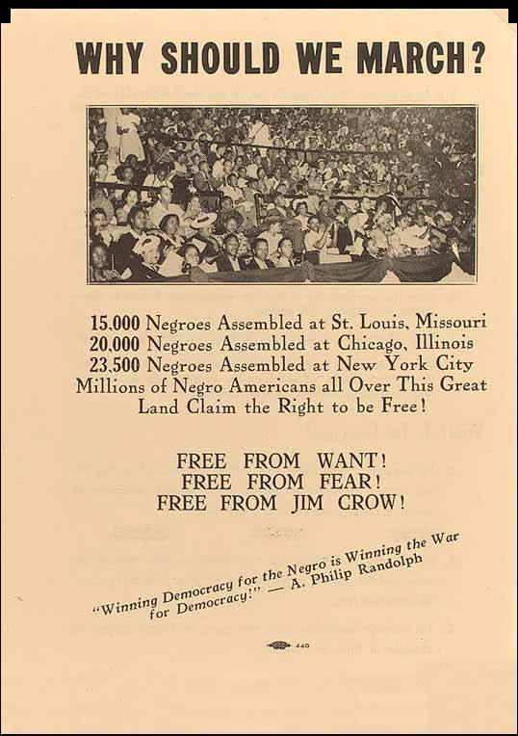
Flyers, posters, cartoons
Notes:
When asked, everybody hold up a sign and then draw it out. It could be “name a type of primary source” OR it could be—one image and students say (or hold signs that indicate primary or secondary….) offer both versions…

Slide 34
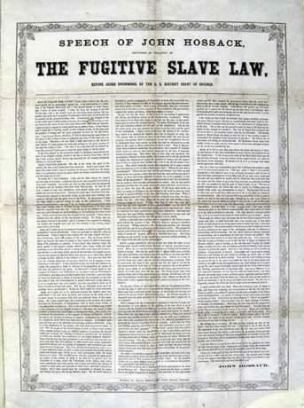
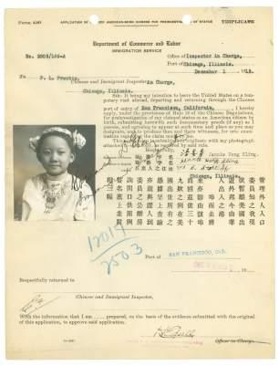
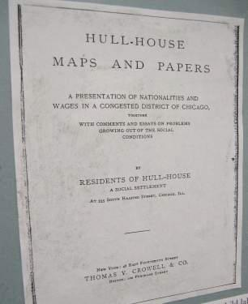
Reports, government documents, laws, trials, meeting minutes
Notes:
When asked, everybody hold up a sign and then draw it out. It could be “name a type of primary source” OR it could be—one image and students say (or hold signs that indicate primary or secondary….) offer both versions… OF COURSE, one could ask, if they had a few weeks—and what could you learn from that document???

Slide 35
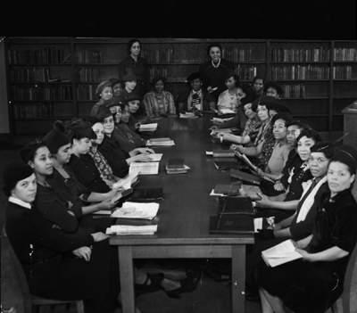
Also look for…
Speeches
Interviews
Oral Histories
Letters
Diaries
Notes:
When asked, everybody hold up a sign and then draw it out. It could be “name a type of primary source” OR it could be—one image and students say (or hold signs that indicate primary or secondary….) offer both versions…

Slide 36
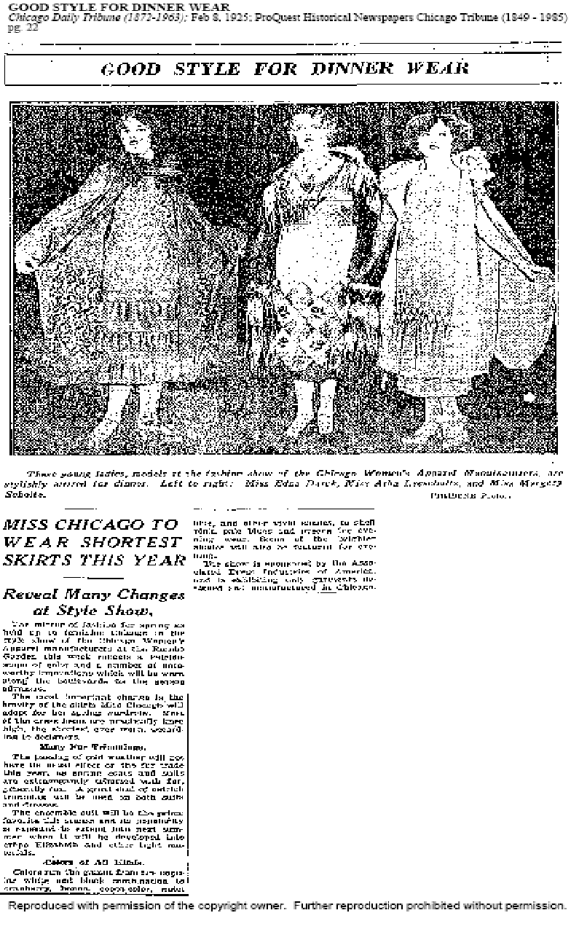
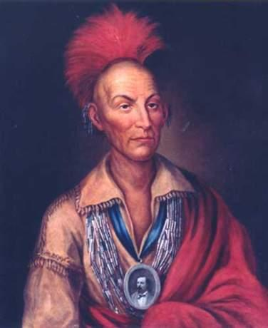
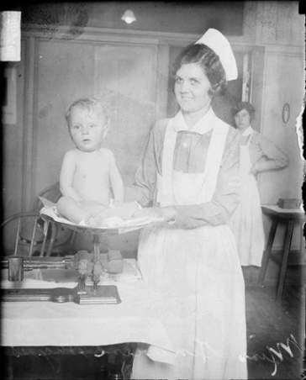
Primary or Secondary?
For more on Research, see the Research Journey powepoint on the History Fair “Doing History” section of the newspaper.
Notes:
When asked, everybody hold up a sign and then draw it out. It could be “name a type of primary source” OR it could be—one image and students say (or hold signs that indicate primary or secondary….) offer both versions… OR do a mix-up for final one and kids have to say “primary” or secondary”

Slide 37
Where can you find them?
libraries
archives
interviews
neighborhoods
organizations
historic sites
museums
Internet-online databases and digital collections
Notes:
This could be another one where students hold up signs. OR not use at all—just brainstorm and see how many students can offer.

Slide 38
“Follow the Footnotes”
THE BEST SECONDARY SOURCES CAN LEAD TO:
OTHER KEY SECONDARY SOURCES
WHERE TO FIND PRIMARY SOURCES
AND OFTEN WILL CONTAIN PRIMARY SOURCES

Slide 39
What makes a quality website for online primary and secondary sources?
Check out the Recommended Websites page on CMHEC’s website
.edu - look for digitized images and documents or articles/reports authored by professors. Avoid .edu websites made by other students
.gov - look for the real images and documents, authorized articles rather than “public relations pages”
.org - can be ok if it is credible and authored by an expert. You might need to dig to determine
Wikipedia? OK for background to get you going, but not for bibliographies.
.com - “unauthored sites” are not credible.
Note: Google, Yahoo, Ask.com are search engines, not sources. Think of a search engine as a LIBRARY. It is a place that has sources for you to find.

Slide 40
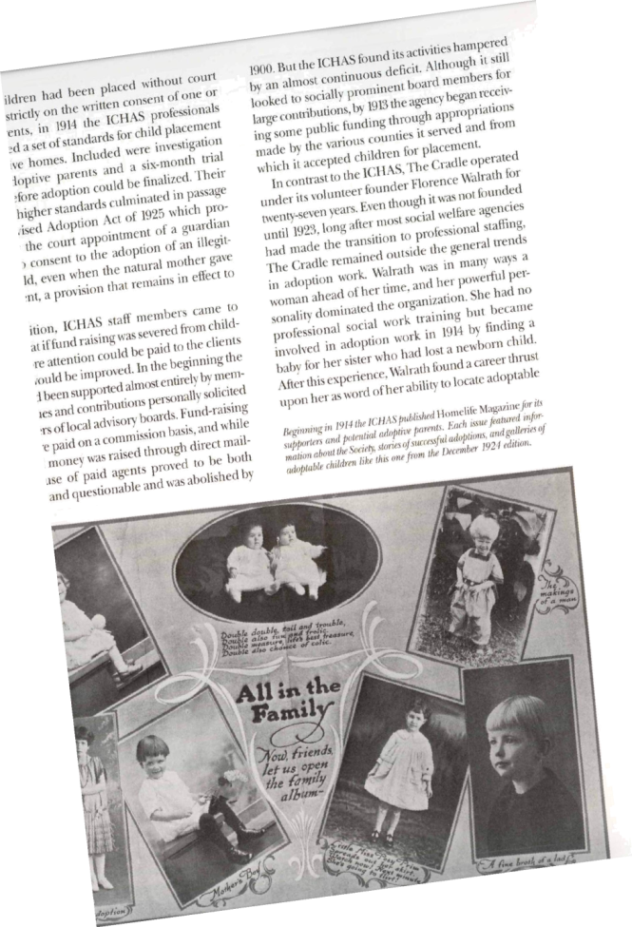
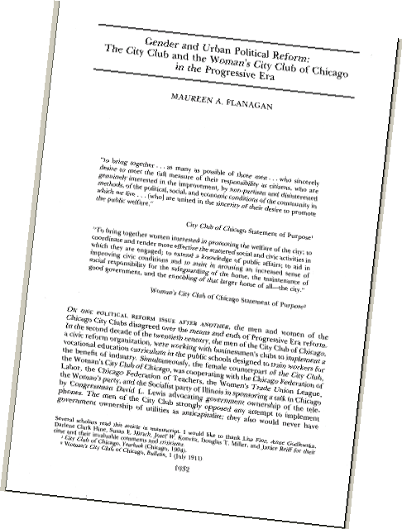
ONLINE databases for secondary sources are great! Sometimes the secondary sources will use primary sources that are hard to find elsewhere too.
J-STOR and “First Search” and other online databases are available at all CPL branches.
Notes:
In books and articles, follow the footnote trail in the bibliographies and citations.

Slide 41
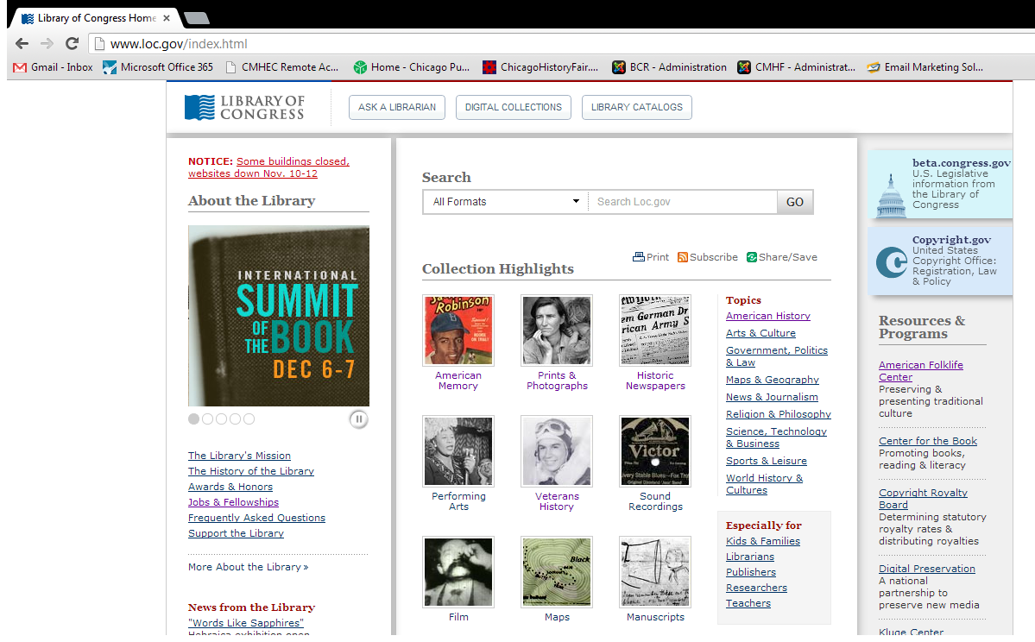
Superior websites give you real primary sources and are usually connected to universities, government, historical societies/museums, special collections
Notes:
Good and bad websites. Or use next slide, which is good? Which is bad? Why?

Slide 42
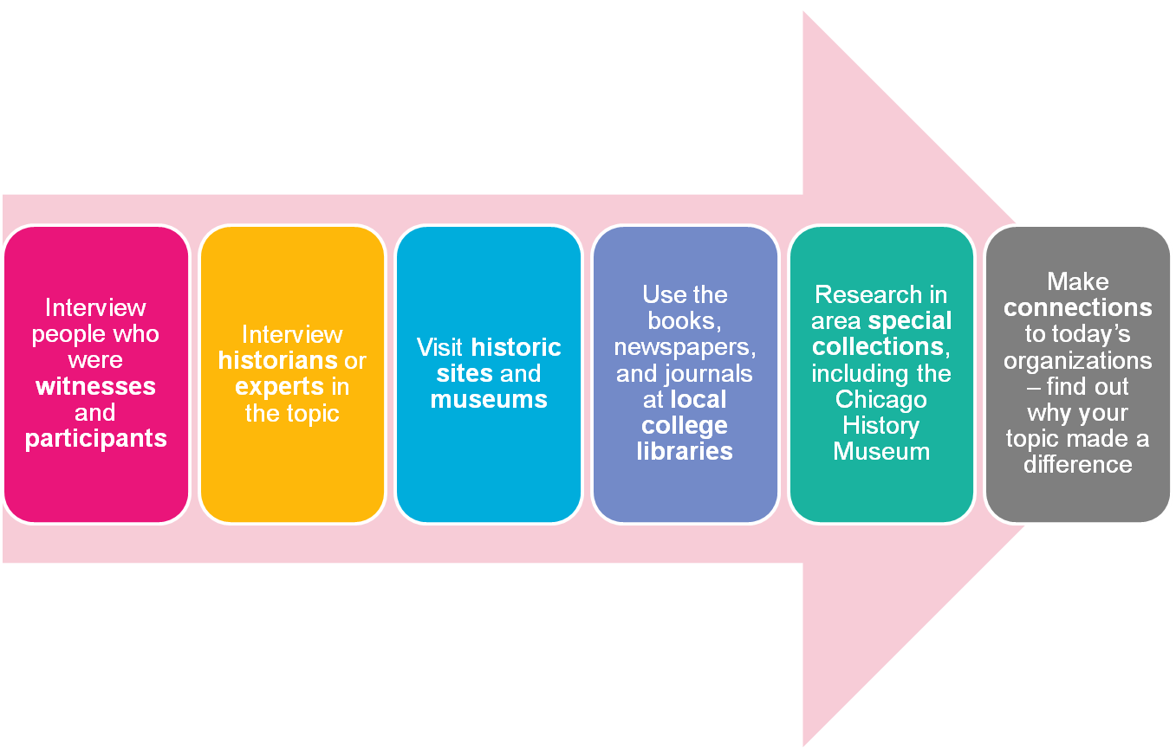
You can make History Fair one of the highlights of this school year

Slide 43
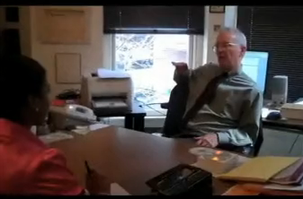
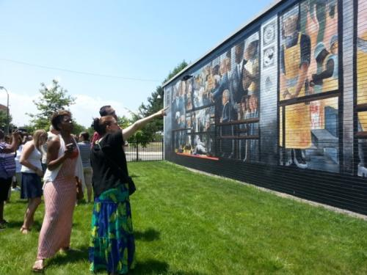
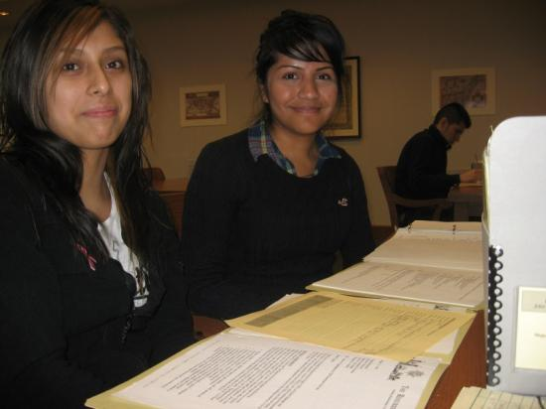
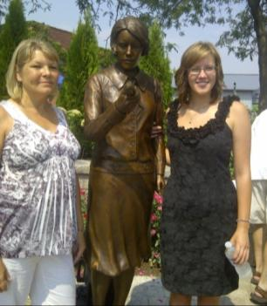
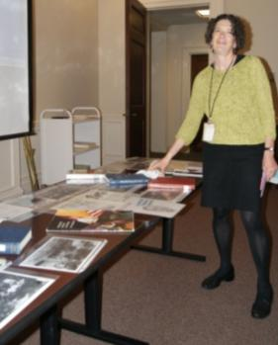
History Fair research is more than an assignment – it can be an experience.

Slide 44
Just like historians, you will need to submit an Annotated Bibliography with your project:
A bibliography contains citations--the detailed publication information--about every source you used.
An annotation is your summary of the source and explanation of how it was used in your project.
(You will attach your Annotated Bibliography to the Summary Statement Form to give to your judges.)

Slide 45
Annotated Bibliography
The annotation summarizes the source and explains how it was used in project.
Bibliographic Information may be either MLA or Turabian style. Be consistent.
Primary and Secondary Sources should be separated.
Notes:
This is not an example of the best annotated bibliography. How could it be improved? Check out the bibliographies in our “Gallery.”

Slide 46
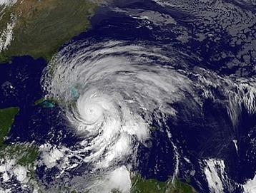
Keep track of all your sources as you are doing your research or you could get lost by the end of the journey.
RECORD ALL THE INFORMATION FOR YOUR BIBLIOGRAPHY WHILE YOU ARE LOOKING AT THE SOURCE!

Slide 47
Step 3 What do I do with all of this?!?
Note-Taking and Analyzing Sources

Slide 48
When you’re researching, organize what you are finding into six main areas:
Description: who, what, when, where
Historical context
What happened: how and why
Causes or contributing factors
What changed and why: effects and impact
Significance
Your notes=the information you are finding but ALSO your analysis of that information
Notes:
Sometimes research can seem really overwhelming. “There’s all this stuff! What do I do with it?” The trick is to keep organized, take good notes, and ask meaningful questions of the sources you are using. KEEP A BINDER or other system to keep organized. Use DOUBLE or TRIPLE ENTRY for note-taking.

Slide 49
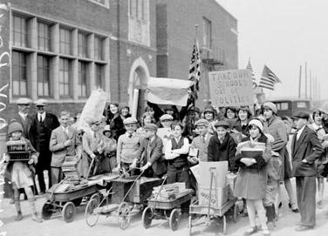
What is context?
Background
How were things done or thought before the change?
What else was going on at the same time that connects?
Who else was involved at the time?
What is the particular era in history called and how does your story fit in?

Slide 50
What makes a topic “Historically Significant?”
Profound: How deeply people were or have been affected, lives changed?
Quantity: Did it affect many or just a few? Were the effects widespread or limited?
Durable: Did the effects last a long time or fade quickly?
Relevant: How does it contribute to our understanding of the past/present? Does it carry any meaning to historians today—can we learn from it?

Slide 51
Once you’ve narrowed your topic, asked a historical question and done more research, you will be able to write a “working” thesis.
A thesis statement tells us in one or two sentences what you are going to argue for in your project. It is your answer to your historical question.
Notes:
A “working thesis” means what YOU think is going on…but might change or need to be revised as you do deeper research

Slide 52
A strong thesis:
Takes a stand -- makes a specific argument or interpretation
Has a narrow and specific focus
Based on & can be supported with evidence
Explains historical impact, significance, or change over time, and
Can be communicated in one or two sentences.

Slide 53
In other words…
What’s your point?
You know you have a thesis if someone else could make a different argument!
Notes:
This is the short-handed way that explains the “so what” factor –why it is important

Slide 54
Evaluate these theses
After the 1919 riot the means of enforcing segregation became more accepted, more formal, often more violent, and completely legal.
Pesticides kill thousands of farm workers and must be stopped.
How did The Jungle make an impact on the foods we eat?
The Juvenile Court system was established to remove children from the adult criminal justice system and help them reform, but over the years it became a source of punishment and imprisonment.
Richard J. Daley died in 1976.
Notes:
Raise hands or signs yes/no and then why or divide into five groups?

Slide 55
Strong or weak thesis statements?
Since their introduction into farming by Mansuto in 1951, pesticides have killed thousands of farm workers and must be stopped.
The Juvenile Court system was established to remove children from the adult criminal justice system and help them reform, but over the years it stopped focusing on rehabilitation of the children and became a source of punishment and imprisonment.
Notes:
A shorter version. Trickier than just a fact statement because the first one does make an argument—but is not historical.

Slide 56
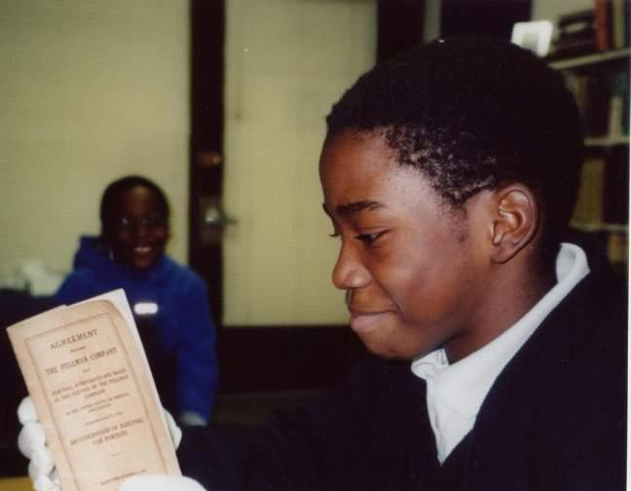
Analyze your sources because they will help you figure out your argument.

Slide 57
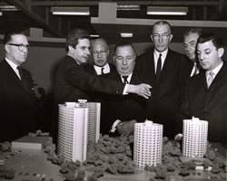
Analyze for Author Audience Purpose Context Issue Impact Significance
How does this source help me better understand my topic?
How does it relate to my thesis?
Notes:
Let’s analyze this source together.

Slide 58
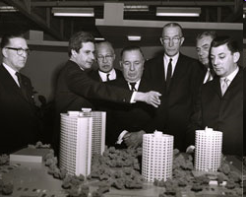
TRY IT!
Courtesy of the Chicago Housing Authority Archives
Notes:
Alternative or additional. What’s going on here? Think of another source you could find to help make sense of this photo.

Slide 59
The sources are evidence for your argument
ANALYZE THIS PHOTOGRAPH: How might it relate to either thesis?
What other sources would you need to find for either thesis?
Public housing failed under Mayor Richard J. Daley because it did not take into account tenants’ needs, but instead it focused on the warehousing of poor people into large units.
Mayor Richard J. Daley’s vision for public housing was to provide the kind of living spaces which would be on par with any middle class housing.
Notes:
Analyze the photo to see which thesis it most supports. Would students need to see more evidence in order to reach their conclusions? Brainstorm what other sources might be needed to help build the argument.

Slide 60
Step 4 Putting it all Together
Thesis
Argument
Evidence (sources)
Conclusion
Thinking like a historian
and developing your argument with evidence

Slide 61
Just like a historian, keep these things in mind when making decisions about what is important enough to include in the story:
Causes and effects
What changed over time?
Why and how did events develop as they did?
What was the impact?
So what? Why does this history matter today?

Slide 62
Just like a historian, you will need to synthesize—or, connect your sources and information to make your historical argument that backs up your thesis.

Slide 63
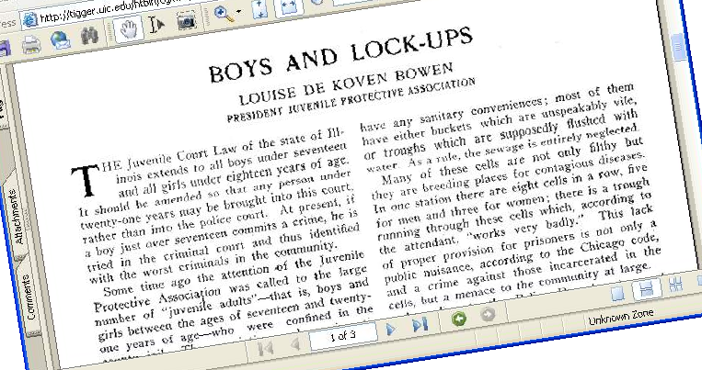
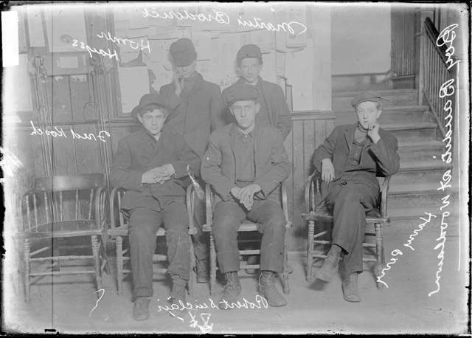
Make connections between the primary and secondary sources

Slide 64
Support an argument with claims and evidence
Claims=each major point you make in order to have us understand and believe your argument which you will back up with evidence. Every claim is supported by several sources. Think of a claim as a “topic sentence.”

Slide 65
Support an argument with claims and evidence
Introduction with thesis
Claim 1 – The relevant background and historical context
Claim 2 – The set-up or development of the issue, problem
Claims 3 & 4 - Central action – and main idea –what happens, why, how change occurred
Claim 5 – Initial outcomes and impact
Claim 6 – Significance. Why it matters today, what was learned, how was “society” changed.
Conclusion (wrap-up)

Slide 66
The introduction is the ROAD MAP for the project’s entire argument. Your thesis is part of the introduction.
No matter what type of project you are doing, you will have an introduction to set-it up for your audience so they know what to look for in your project.

Slide 67
LET’S ANALYZE THIS INTRODUCTION: DOES IT HAVE ALL THE ELEMENTS THAT MAKE A STRONG INTRODUCTION?
The Northern Illinois Hospital and Asylum for the Insane was first proposed by the state legislature on April 16, 1869. It was created because the northern Illinois and Chicago-land area needed an asylum and Elgin had the 155 acres that was needed. It received its first patients on April 3, 1872. Before this time, many hospitals for the insane were like prisons, and the patients were treated like animals. The state wanted the hospital to have all of the newest technology for treatments and the best of living conditions for its patients and employees. Through the years it became clear that Elgin Mental Health Center was not helping its patients and sometimes even hurting them, so major changes were made to improve living conditions and treatment methods. The hospital became an example of both what to do and what not to do to improve many hospitals throughout the region and beyond.
Context? Change over time? Historical significance? Thesis?
Notes:
Unpack this—context, change, historical significance, identify the thesis (did the kid really need to use the word thesis however????) I LIKE THIS WAY BETTER THAN 1919, IF IT’S READABLE…

Slide 68
The Northern Illinois Hospital and Asylum for the Insane was first proposed by the state legislature on April 16, 1869. It was created because the northern Illinois and Chicago-land area needed an asylum and Elgin had the 155 acres that was needed. It received its first patients on April 3, 1872.
Before this time, many hospitals for the insane were like prisons, and the patients were treated like animals. The state wanted the hospital to have all of the newest technology for treatments and the best of living conditions for its patients and employees.
Through the years it became clear that Elgin Mental Health Center was not helping its patients and sometimes even hurting them, so major changes were made to improve living conditions and treatment methods.
The hospital became an example of both what to do and what not to do to improve many hospitals throughout the region and beyond.
CONTEXT
CHANGE OVER TIME
THESIS
HISTORICAL SIGNIFICANCE

Slide 69
Your conclusion not only summarizes your argument, it tells us why this matters — what we can learn from history to understand today.
Notes:
The rest of the project follows from the introduction and develops the interpretation by going point by point and proving through sources. The next section will develop this point further

Slide 70
Step 5 Tell Us Your Story
Visit the History Fair website to find more guidelines, samples, and the rules for each category.

Slide 71
History Fair offers many ways to communicate your interpretation…. Choose a project that will communicate your topic most effectively. For example, a topic with few visuals would probably make a better paper than an exhibit board or website.
Notes:
As the teacher(s) allow…

Slide 72
Exhibits
Lots of visual sources
Excellent, tight, writing
Graphic design and creativity
Easy to follow
Organized like a mini-museum
Notes:
Compare bad & good exhibits—and why

Slide 73
INTRODUCTION IN EITHER PLACE. Title on a header-board or make room at the top
IMPACT & LONG- LASTING SIGNIFICANCE
Use subheads and segments to move along the story in each section
CONTEXT & BACKGROUND and set-up
MAIN IDEA & EVIDENCE
CONCLUSION
Notes:
Show samples of exhibits again and point out organization – especially subheads and why they are important to organizing the exhibit! Think of the exhibit as a museum. Each section a wall in an exhibit. OR as chapters in a book…or even a paper: intro, body, conclusion

Slide 74
In an exhibit, the label tells the story—the surrounding sources provide the evidence and give detail to the story.

Slide 75
(Notice the summary statement form and annotated bibliography placed in front of the exhibit.)
Notes:
Can you spot the other labels? Note the subheads that organize your interpretation? Go back and look at the other exhibits used in this presentation too!

Slide 76
Performances
Dramatic or enjoy talking with the public
Many sources are text, few visuals
Do not want to write a research paper
Want to try writing a script and block out moves
Willing to practice your script
Individual or groups

Slide 77
Websites
Learn how to build a website (no need to know HTML code)
Graphic design
Many visual sources
Audio sources
Footage sources
Interactivity

Slide 78
Research Papers
Best able to express ideas through writing
Few visual sources available
Individuals only

Slide 79
Documentaries
Know how or would like to learn how to use the technology such as camcorder, documentary editing equipment
Want to write a script
Topic has lots of visual sources
Topic has audio sources (interviews, music)
Individual or groups

Slide 80
A superior presentation is:
Clear about the thesis, argument, and conclusion,
Written so that the labels or the script are organized and easy to understand,
Interesting and creative.
Shows evidence that supports your case—everything relates to your thesis.
Notes:
Your History Fair project is your opportunity to present your conclusions to a public audience. While it’s important for your project to be creative and interesting, the heart of a solid project is not glitz—it’s a well-defined and communicated argument supported by evidence.

Slide 81
How will my project be evaluated?
Volunteer judges work together to review your project and evaluate it on:
Knowledge
Analysis
Sources
Presentation

Slide 82
The Summary Statement for Judges
Students state their thesis, summarize the main ideas of their project, and explain their process of creating their History Fair project.
Lots of penalty points if you do not have a Summary Statement Form and Annotated Bibliography!

Slide 83
Where can you go with your History Fair project?

Slide 84
School Fair
Citywide Fair
Finals (high school only)
State Expo
Public Presentations
National History Day
You may earn cash prizes and be eligible for a college scholarship!

Slide 85
Visit our website for more information, ideas, and samples
www.chicagohistoryfair.org
Notes:
For History Fair Rules, Resources, Samples and Advice OR TO CONTACT us with questions

Slide 86
Photo Credits
Slide 11: WPA “Censored” poster (“By the People, For the People: Posters from the WPA 1936-1943, Library of Congress, http://memory.loc.gov/ammem/wpaposters/)
Slide 31: The Woodlawn Organization photograph (Industrial Area Foundation, Daley Library Special Collections Department, University of Illinois at Chicago); Memo (National Archives & Records Administration, Great Lakes Regional Center); Chicago World’s Fair poster, “Preventable Diseases” poster Board of Public Health Reports, Chicago Public Library; Chicago Defender front page
Slide 32: Chemical man photograph (FSA-OWI Photographs, American Memory, Library of Congress); Memorial Day Massacre photograph (Illinois Labor History Society).
Slide 34: “Why Should We March?” flier (African-American Odyssey, American Memory, Library of Congress); Fugitive Slave broadside (Newberry Library); Naturalization application (National Archives & Records Administration, Great Lakes Regional Center); Hull House Report; Memo (National Archives & Records Administration, Great Lakes Regional Center)
Slide 36: Women intellectuals photograph (Hall Branch Archives 033, Vivian Harsh Collection, Chicago Public Library)
Slide 37: Portrait of Black Hawk (Courtesy Chicago History Museum); Nurse and infant photograph (DN-0085482, Chicago Daily News negatives collection, Chicago Historical Society); Newspaper article
Slide 48: Daley and public housing photograph (www.roosevelt.edu/gagegallery/promise.htm)
Slide 49: “Why Should We March?” flier (African-American Odyssey, American Memory, Library of Congress)
Slide 50: Juveniles awaiting trial photograph (DN-0004676, Chicago Daily News negatives collection, Chicago Historical Society)

